Slide 1
Data Communication and
Networks

Slide 2
Network Layer
Congestion Control and QoS

Slide 3
Overview
Introduction
Congestion Control Algorithms
Principles of Congestion Control
Congestion Prevention Policies
Quality of Service

Slide 4
Introduction
too many packets are present in the subnet, performance degrades.
no. of packets dumped into the subnet by the hosts is within its carrying capacity, they are all delivered.
However, as traffic increases too far, the routers are no longer able to cope and they begin losing packets.
At very high traffic, performance collapses completely and almost no packets are delivered.

Slide 5
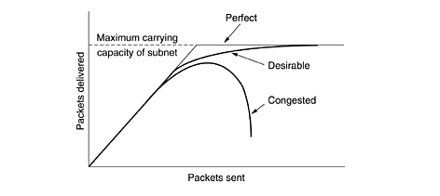
Fig: When too much traffic is offered, congestion sets in and performance degrades sharply.

Slide 6
Congestion can be brought on by several factors.
sudden arriving of packets on three or four input lines and all need the same output line, a queue will build up.
insufficient memory to hold all of them, packets will be lost.
Slow processors
low-bandwidth lines
mismatch between parts of the system

Slide 7
Difference between congestion control & flow control
Congestion control is a global issue
    involving the behavior of all the hosts, all the routers, the store-and-forwarding processing within the routers.
Flow control relates to the point-to-point traffic between a given sender and a given receiver.
    involves some direct feedback from the receiver to the sender to tell the sender how things are doing at the other end.

Slide 8
congestion control and flow control are often confused
some congestion control algorithms operate by sending messages back to the various sources telling them to slow down when the network gets into trouble.
Thus, a host can get a ''slow down'' message either because the receiver cannot handle the load or because the network cannot handle it.

Slide 9
General Principles of Congestion Control
Many problems in complex systems, such as computer networks, can be viewed from a control theory point of view.
This approach leads to dividing all solutions into two groups:
    open loop
    closed loop

Slide 10
Open loop
solutions attempt to make sure it does not occur in the first place.
Once the system is up and running, midcourse corrections are not made.
Tools for doing open-loop control include deciding when to accept new traffic, deciding when to discard packets and which ones, and making scheduling decisions at various points in the network.
All of these have in common the fact that they make decisions without regard to the current state of the network.

Slide 11
Closed loop
based on the concept of a feedback loop.
approach has three parts when applied to congestion control:
  Monitor the system to detect when and where congestion occurs.
  Pass this information to places where action can be taken.
  Adjust system operation to correct the problem.

Slide 12
First step
variety of metrics can be used to monitor the subnet for congestion.
  percentage of all packets discarded for lack of buffer space,
  average queue lengths,
  number of packets that time out and are retransmitted,
  Average packet delay, and the standard deviation of packet delay.

Slide 13
Second step
transfer the information about the congestion from the point where it is detected to the point where something can be done about it.

Slide 14
Various approach to inform about congestion
the router detecting the congestion to send a packet to the traffic source or sources, announcing the problem.
router detects this congested state, it fills in the field in all outgoing packets, to warn the neighbors.
hosts or routers periodically send probe packets out to explicitly ask about congestion.

Slide 15
Yang and Reddy (1995) have developed taxonomy for congestion control algorithms.
dividing all algorithms into open loop or closed loop.
further divide the open loop algorithms into ones that act at the source versus ones that act at the destination.
closed loop algorithms are also divided into two subcategories:
Explicit feedback
Implicit feedback

Slide 16
explicit and implicit feedback algorithms
explicit feedback algorithms, packets are sent back from the point of congestion to warn the source.
implicit algorithms, the source deduces the existence of congestion by making local observations, such as the time needed for acknowledgements to come back.
The presence of congestion means that the load is (temporarily) greater than the resources (in part of the system) can handle.

Slide 17
Congestion Prevention Policies
First our study of methods to control congestion by looking at open loop systems.
These systems are designed to minimize congestion in the first place, rather than letting it happen and reacting after the fact.
They try to achieve their goal by using appropriate policies at various levels like
      data link,
      network, and
      transport

Slide 18
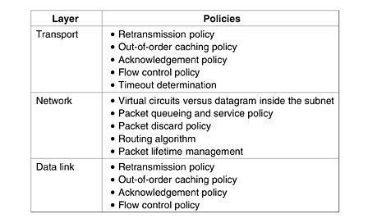
Fig: Policies that affect congestion.

Slide 19
Data link layer
retransmission policy is concerned with how fast a sender times out and what it transmits upon timeout.
A jumpy sender that times out quickly and retransmits all outstanding packets using go back n will put a heavier load on the system than will a leisurely sender that uses selective repeat.
Closely related to this is the buffering policy.
If receivers routinely discard all out-of-order packets, these packets will have to be transmitted again later, creating extra load.
With respect to congestion control, selective repeat is clearly better than go back n.

Slide 20
Acknowledgement policy also affects congestion. If each packet is acknowledged immediately, the acknowledgement packets generate extra traffic.
However, if acknowledgements are saved up to piggyback onto reverse traffic, extra timeouts and retransmissions may result.
tight flow control scheme (e.g., a small window) reduces the data rate and thus helps fight congestion.

Slide 21
Network layer
choice between using virtual circuits and using datagrams affects congestion since many congestion control algorithms work only with virtual-circuit subnets.
Packet queueing and service policy relates to whether routers have one queue per input line, one queue per output line, or both. It also relates to the order in which packets are processed (e.g., round robin or priority based).
Discard policy is the rule telling which packet is dropped when there is no space.

Slide 22
Finally, packet lifetime management deals with how long a packet may live before being discarded.
If it is too long, lost packets may clog up the works for a long time,
If it is too short, packets may sometimes time out before reaching their destination, thus inducing retransmissions.

Slide 23
Transport layer
In the transport layer, the same issues occur as in the data link layer.
in addition, determining the timeout interval is harder because the transit time across the network is less predictable than the transit time over a wire between two routers.
If the timeout interval is too short, extra packets will be sent unnecessarily.
If it is too long, congestion will be reduced but the response time will suffer whenever a packet is lost.

Slide 24
Congestion Control in Virtual-Circuit Subnets
One approach that is widely used to keep congestion that has already started from getting worse is admission control.
once congestion has been signaled, no more virtual circuits are set up until the problem has gone away.
This approach is crude, it is simple and easy to carry out.
In the telephone system, when a switch gets overloaded, it also practices admission control by not giving dial tones.
Alternative approach is to allow new virtual circuits but carefully route all new virtual circuits around problem areas.

Slide 25
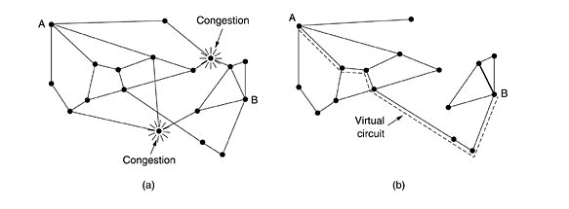
Figure 2. (a) A congested subnet. (b) A redrawn subnet that eliminates the congestion. A virtual circuit from A to B is also shown.

Slide 26
Another strategy relating to virtual circuits is to negotiate an agreement between the host and subnet when a virtual circuit is set up.
agreement normally specifies the volume and shape of the traffic, quality of service required, and other parameters.
the subnet will typically reserve resources along the path when the circuit is set up.
These resources can include table and buffer space in the routers and bandwidth on the lines.
disadvantage is that it tends to waste resources.

Slide 27
Congestion Control in Datagram Subnets
Each router can easily monitor the utilization of its output lines and other resources.
it can associate with each line a real variable, u, whose value, between 0.0 and 1.0, reflects the recent utilization of that line.
  U_{new} = au_{old} + (1 – a)f
where the constant a determines how fast the router forgets recent history.
Whenever u moves above the threshold, the output line enters a ''warning'' state.
Each newly-arriving packet is checked to see if its output line is in warning state. If it is, some action is taken.

Slide 28
The Warning Bit
old DECNET architecture signaled the warning state by setting a special bit in the packet's header
When the packet arrived at its destination, the transport entity copied the bit into the next acknowledgement sent back to the source.
The source then cut back on traffic.
source monitored the fraction of acknowledgements with the bit set and adjusted its transmission rate accordingly.

Slide 29
Choke Packets
router sends a choke packet back to the source host, giving it the destination found in the packet.
source host gets the choke packet, it is required to reduce the traffic sent to the specified destination by X percent.
After that period has expired, the host listens for more choke packets for another interval.
feedback implicit in this protocol can help prevent congestion yet not throttle any flow unless trouble occurs.
Hosts can reduce traffic by adjusting their policy parameters, for example, their window size.

Slide 30
Hop-by-Hop Choke Packets
At high speeds or over long distances, sending a choke packet to the source hosts does not work well because the reaction is so slow.
Consider, for example, a router A in Figure 5.28(a) is sending traffic to a host in D in Figure at 155 Mbps.
If the D router begins to run out of buffers, it will take about 30 msec for a choke packet to get back to A to tell it to slow down.

Slide 31
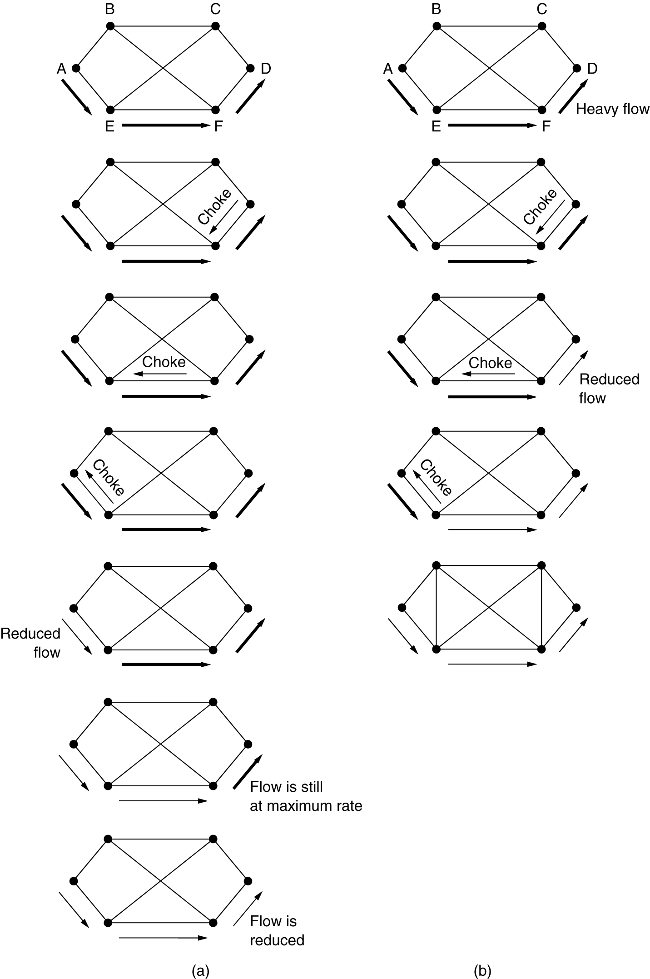
Figure: (a) A choke packet that affects only the source. (b) A choke packet that affects each hop it passes through.

Slide 32
Load Shedding
fancy way of saying that when routers are being inundated by packets that they cannot handle, they just throw them away.
A router drowning in packets can just pick packets at random to drop, but usually it can do better than that.
Which packet to discard may depend on the applications running.
For file transfer, an old packet is worth more than a new one
For multimedia, a new packet is more important than an old one.

Slide 33
Random Early Detection
dealing with congestion after it is first detected is more effective than letting it gum up the works and then trying to deal with it.
A popular algorithm for doing this is called RED (Random Early Detection) (Floyd and Jacobson, 1993).
In some transport protocols (including TCP), the response to lost packets is for the source to slow down.
The reasoning behind this logic is that TCP was designed for wired networks and wired networks are very reliable.
lost packets are mostly due to buffer overruns rather than transmission errors. This fact can be exploited to help reduce congestion.

Slide 34
Jitter Control
For applications such as audio and video streaming, it does not matter much if the packets take 20 msec or 30 msec to be delivered, as long as the transit time is constant.
The variation (i.e., standard deviation) in the packet arrival times is called jitter.
The jitter can be bounded by computing the expected transit time for each hop along the path.

Slide 35
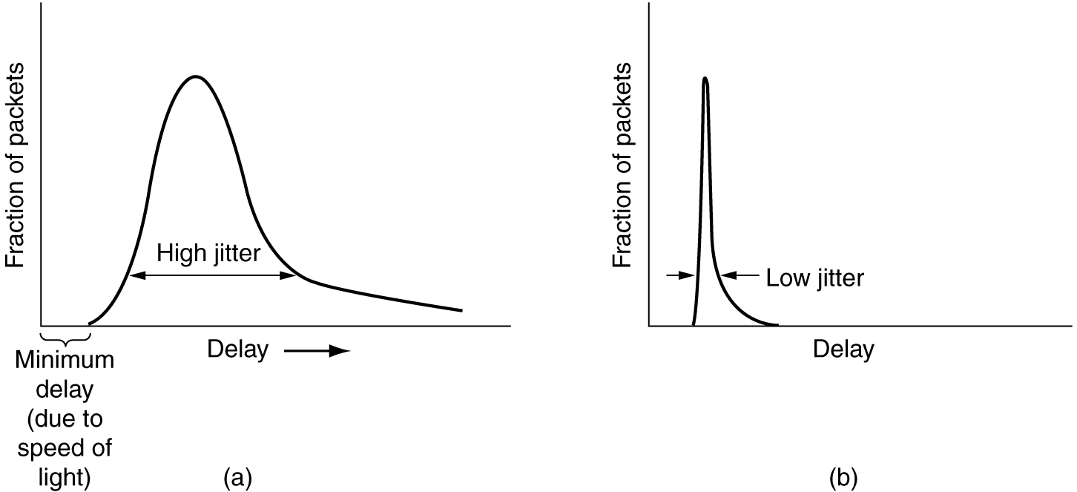
Jitter Control
(a) High jitter. (b) Low jitter.

Slide 36
When a packet arrives at a router, the router checks to see how much the packet is behind or ahead of its schedule. This information is stored in the packet and updated at each hop.
If the packet is ahead of schedule, it is held just long enough to get it back on schedule.
If it is behind schedule, the router tries to get it out the door quickly.

Slide 37
In some applications, such as video on demand, jitter can be eliminated by buffering at the receiver and then fetching data for display from the buffer instead of from the network in real time.
However, for other applications, especially those that require real-time interaction between people such as Internet telephony and videoconferencing, the delay inherent in buffering is not acceptable.

Slide 38
Quality of Service
Growth of multimedia networking, often these (congestion control) ad hoc measures are not enough.
Guaranteeing qualities of service through network and protocol design are needed.
In the following sections sharper focus on ways to provide a quality of service matched to application needs.

Slide 39
Requirements for QoS
A stream of packets from a source to a destination is called a flow.
In a connection-oriented network, all the packets belonging to a flow follow the same route.
In a connectionless network, they may follow different routes.
needs of each flow can be characterized by four primary parameters: reliability, delay, jitter, and bandwidth.

Slide 40
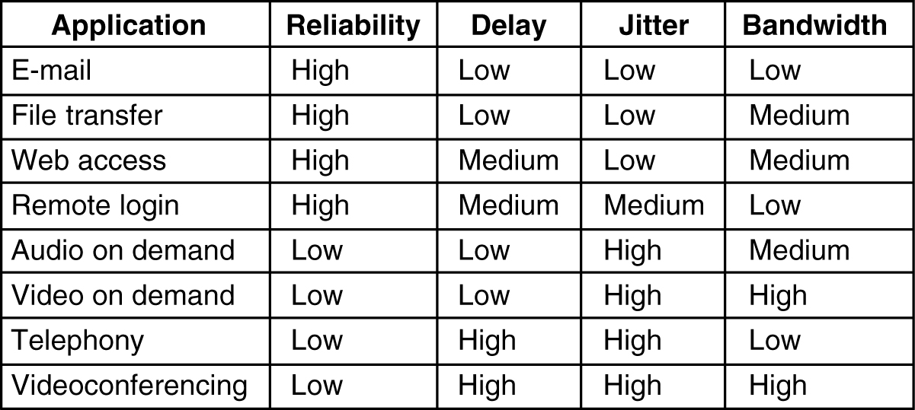

Slide 41
The first four applications have stringent requirements on reliability. No bits may be delivered incorrectly.
Usually achieved by checksumming each packet and verifying the checksum at the destination.
four final (audio/video) applications can tolerate errors, so no checksums are computed or verified
File transfer applications, including e-mail and video, are not delay sensitive.

Slide 42
If all packets are delayed uniformly by a few seconds, no harm is done.
Interactive applications, such as Web surfing and remote login, are more delay sensitive.
Real-time applications, such as telephony and videoconferencing have strict delay requirements.

Slide 43
ATM networks classify flows in four broad categories with respect to their QoS demands as follows:
  Constant bit rate (e.g., telephony).
  Real-time variable bit rate (e.g., compressed videoconferencing).
  Non-real-time variable bit rate (e.g., watching a movie over the Internet).
  Available bit rate (e.g., file transfer).

Slide 44
Constant bit rate is an attempt to simulate a wire by providing a uniform bandwidth and a uniform delay.
Variable bit rate occurs when video is compressed, some frames compressing more than others.
Available bit rate is for applications, such as e-mail, that are not sensitive to delay or jitter.

Slide 45
Techniques for Achieving Good Quality of Service
No single technique provides efficient, dependable QoS in an optimum way.
Instead, a variety of techniques have been developed, with practical solutions often combining multiple techniques.
Overprovisioning
Buffering
Traffic Shaping
The Leaky Bucket Algorithm
The Token Bucket Algorithm
Resource Reservation

Slide 46
Overprovisioning
An easy solution is to provide so much router capacity, buffer space, and bandwidth that the packets just fly through easily.
The trouble with this solution is that it is expensive.

Slide 47
Buffering
Flows can be buffered on the receiving side before being delivered.
Buffering them does not affect the reliability or bandwidth, and increases the delay, but it smoothes out the jitter.
For audio and video on demand, jitter is the main problem, so this technique helps a lot.

Slide 48
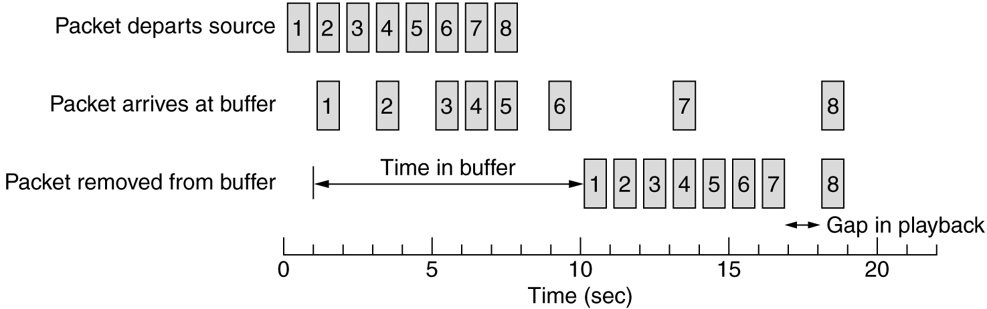
Packet 1 is sent from the server at t = 0 sec and arrives at the client at t = 1 sec.
Packet 2 undergoes more delay and takes 2 sec to arrive.
As the packets arrive, they are buffered on the client machine. At t = 10 sec, playback begins.
At this time, packets 1 through 6 have been buffered so that they can be removed from the buffer at uniform intervals for smooth play.
Unfortunately, packet 8 has been delayed so much that it is not available when its play slot comes up, so playback must stop until it arrives.

Slide 49
Traffic Shaping
Traffic shaping, which smooths out the traffic on the server side, rather than on the client side.
Traffic shaping is about regulating the average rate (and burstiness) of data transmission.
Previous case the source outputs the packets with a uniform spacing between them.
but in other cases, they may be emitted irregularly, which may cause congestion to occur in the network.

Slide 50
Nonuniform output is common if the server is handling many streams at once, and it also allows other actions, such as fast forward and rewind, user authentication, and so on.
Also, the approach we used here (buffering) is not always possible, for example, with videoconferencing.
However, if something could be done to make the server (and hosts in general) transmit at a uniform rate, quality of service would be better.

Slide 51
When a connection is set up, the user and the subnet (i.e., the customer and the carrier) agree on a certain traffic pattern (i.e., shape) for that circuit. Sometimes this is called a service level agreement.
Traffic shaping reduces congestion and thus helps the carrier live up to its promise.
Monitoring a traffic flow is called traffic policing.
Agreeing to a traffic shape and policing it afterward are easier with virtual-circuit subnets than with datagram subnets.

Slide 52
The Leaky Bucket Algorithm
Imagine a bucket with a small hole in the bottom.
No matter the rate at which water enters the bucket, the outflow is at a constant rate, r, when there is any water in the bucket and zero when the bucket is empty.
Also, once the bucket is full, any additional water entering it spills over the sides and is lost (i.e., does not appear in the output stream under the hole).
The same idea can be applied to packets.

Slide 53
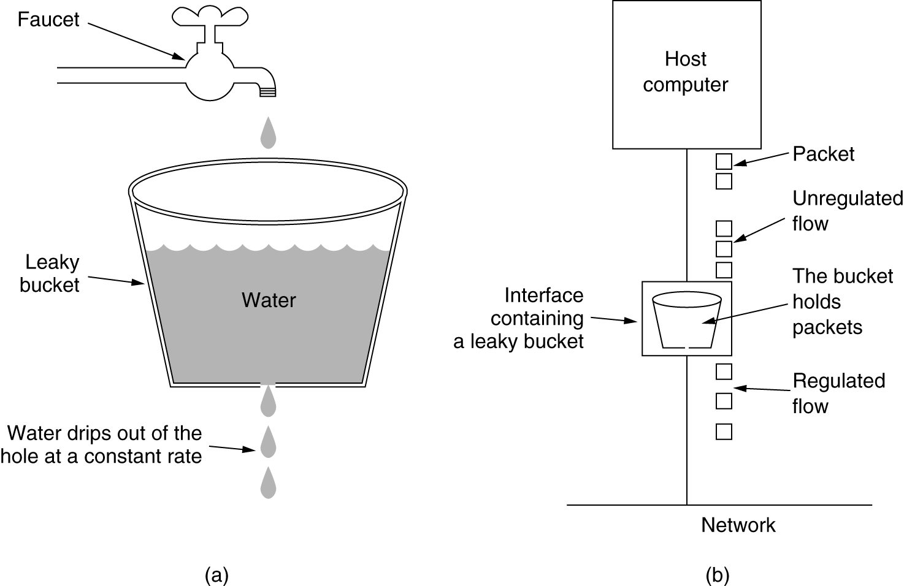
Figure (a) A leaky bucket with water. (b) A leaky bucket with packets.

Slide 54
Conceptually, each host is connected to the network by an interface containing a leaky bucket, that is, a finite internal queue.
If a packet arrives at the queue when it is full, the packet is discarded.
This arrangement can be built into the hardware interface or simulated by the host operating system
It was first proposed by Turner (1986) and is called the leaky bucket algorithm.

Slide 55
In fact, it is nothing other than a single-server queueing system with constant service time.
The host is allowed to put one packet per clock tick onto the network.
Again, this can be enforced by the interface card or by the operating system.
This mechanism turns an uneven flow of packets from the user processes inside the host into an even flow of packets onto the network, smoothing out bursts and greatly reducing the chances of congestion.
When the packets are all the same size (e.g., ATM cells), this algorithm can be used as described.

Slide 56
Implementing the original leaky bucket algorithm is easy.
The leaky bucket consists of a finite queue.
When a packet arrives, if there is room on the queue it is appended to the queue; otherwise, it is discarded.
At every clock tick, one packet is transmitted (unless the queue is empty).

Slide 57
The Token Bucket Algorithm
The leaky bucket algorithm enforces a rigid output pattern at the average rate, no matter how bursty the traffic is.
For many applications, it is better to allow the output to speed up somewhat when large bursts arrive.
For that we need a more flexible algorithm, preferably one that never loses data.
One such algorithm is the token bucket algorithm.
In this algorithm, the leaky bucket holds tokens, generated by a clock at the rate of one token every ∆T sec.

Slide 58
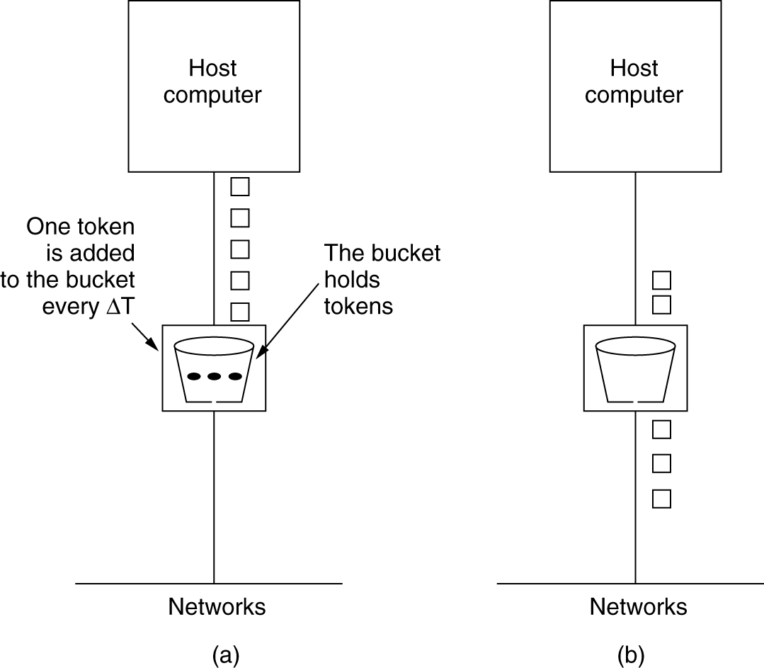
Figure: The token bucket algorithm. (a) Before. (b) After.

Slide 59
Figure (a) we see a bucket holding three tokens, with five packets waiting to be transmitted.
For a packet to be transmitted, it must capture and destroy one token.
Figure (b) we see that three of the five packets have gotten through, but the other two are stuck waiting for two more tokens to be generated.

Slide 60
Comparison between the token bucket algorithm and leaky bucket algorithm.
1. The leaky bucket algorithm does not allow idle hosts to save up permission to send large bursts later.
The token bucket algorithm does allow saving, up to the maximum size of the bucket, n.
This property means that bursts of up to n packets can be sent at once, allowing some burstiness in the output stream and giving faster response to sudden bursts of input.

Slide 61
2. token bucket algorithm throws away tokens (i.e., transmission capacity) when the bucket fills up but never discards packets.
In contrast, the leaky bucket algorithm discards packets when the bucket fills up.
3. The leaky bucket and token bucket algorithms can also be used to smooth traffic between routers, as well as to regulate host output as in our examples.
4. However, one clear difference is that a token bucket regulating a host can make the host stop sending when the rules say it must. Telling a router to stop sending while its input keeps pouring in may result in lost data.

Slide 62
Resource Reservation
Being able to regulate the shape of the offered traffic is a good start to guaranteeing the quality of service.
However, effectively using this information implicitly means requiring all the packets of a flow to follow the same route.
Spraying them over routers at random makes it hard to guarantee anything.

Slide 63
As a consequence, something similar to a virtual circuit has to be set up from the source to the destination, and all the packets that belong to the flow must follow this route.
Once we have a specific route for a flow, it becomes possible to reserve resources along that route to make sure the needed capacity is available.
Three different kinds of resources can potentially be reserved:
  Bandwidth.
  Buffer space.
  CPU cycles.

